Slide 1


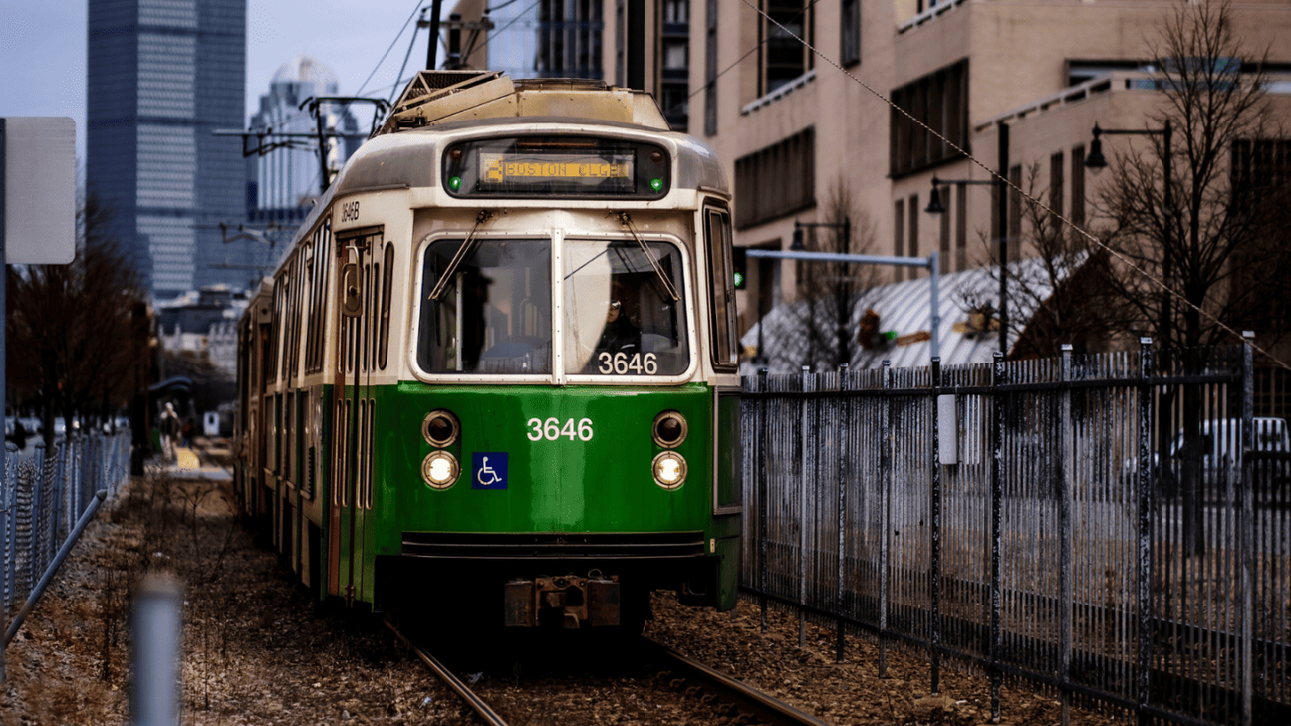


MBTA
PREDICTING TRANSIT RELIABILITY IN MBTA USING MACHINE LEARNING
Presented By : AKHIL, HAMZA, SHON, TANISH

Slide 2
TABLE OF CONTENTS
01
Problem statement
05
Models
02
Data Description
06
Conclusion
03
EDA
07
Recommendation
08
Limitations
04
Reliability Factor

Slide 3
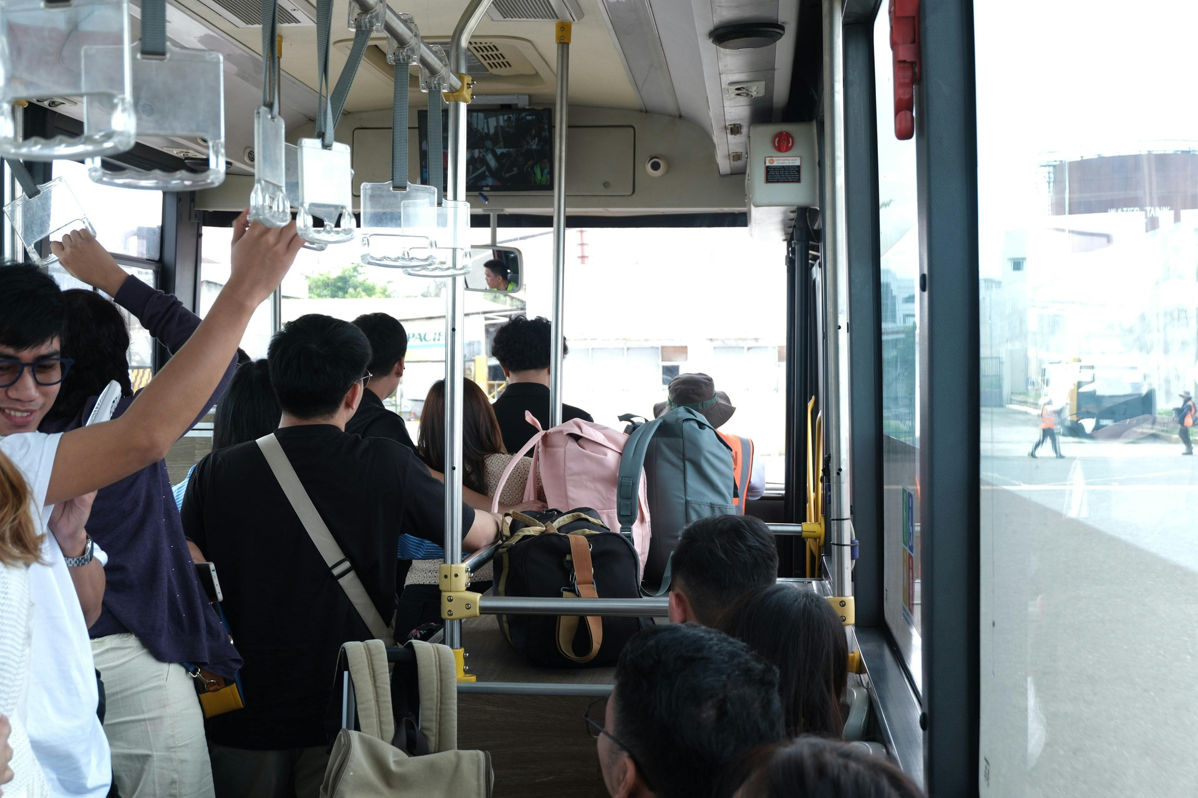
MBTA
PROBLEM STATEMENT
Through this project, we aim to predict the reliability of MBTA transit routes using historical operational and weather data. Our goal is to build a machine-learning model that classifies whether a route will be reliable based on factors such as transit type, peak vs. off-peak hours, route category, and weather conditions. Understanding these patterns helps identify when and why service delays or reliability issues are most likely to occur.

Slide 4
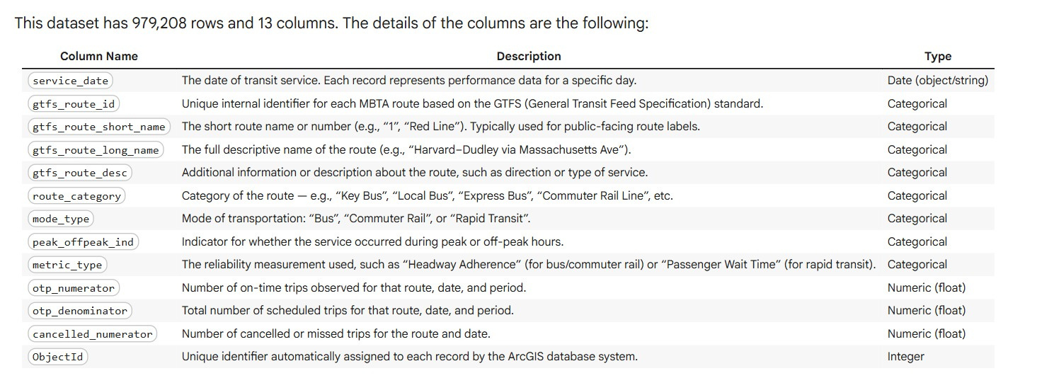
DATA DESCRIPTION

Slide 5
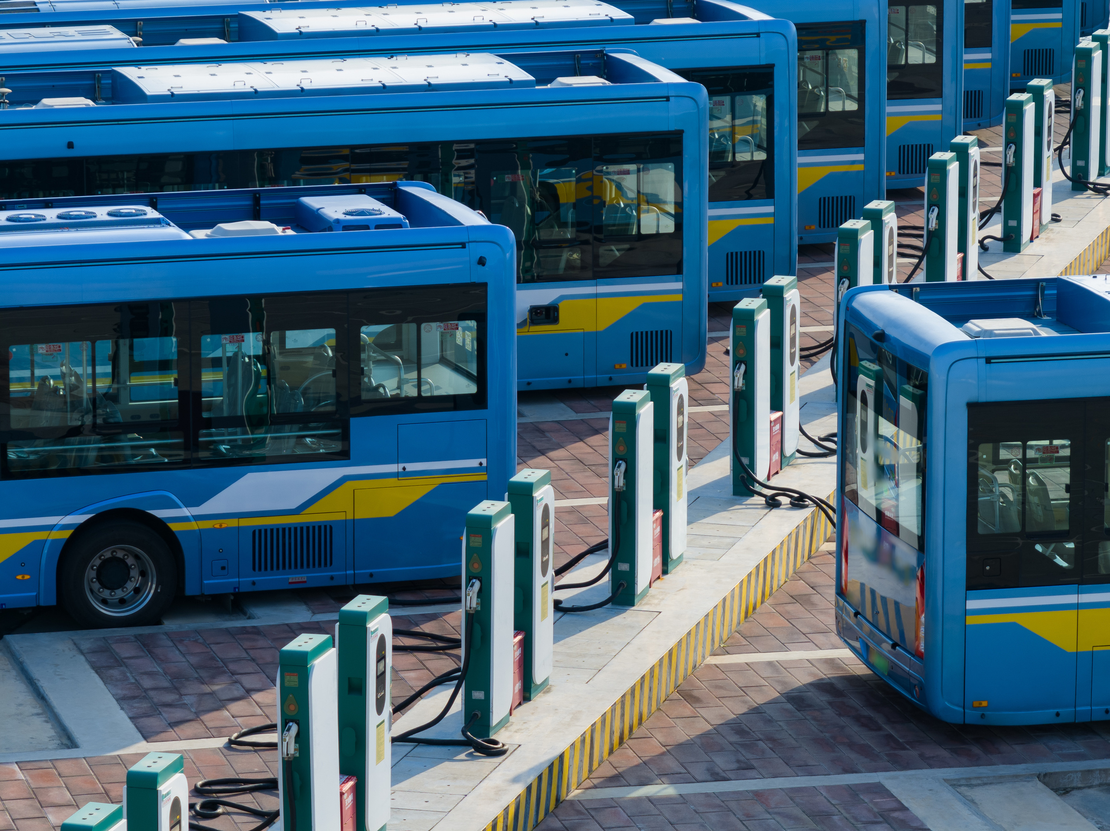
MBTA
EXPLORATORY
DATA
ANALYSIS

Slide 6
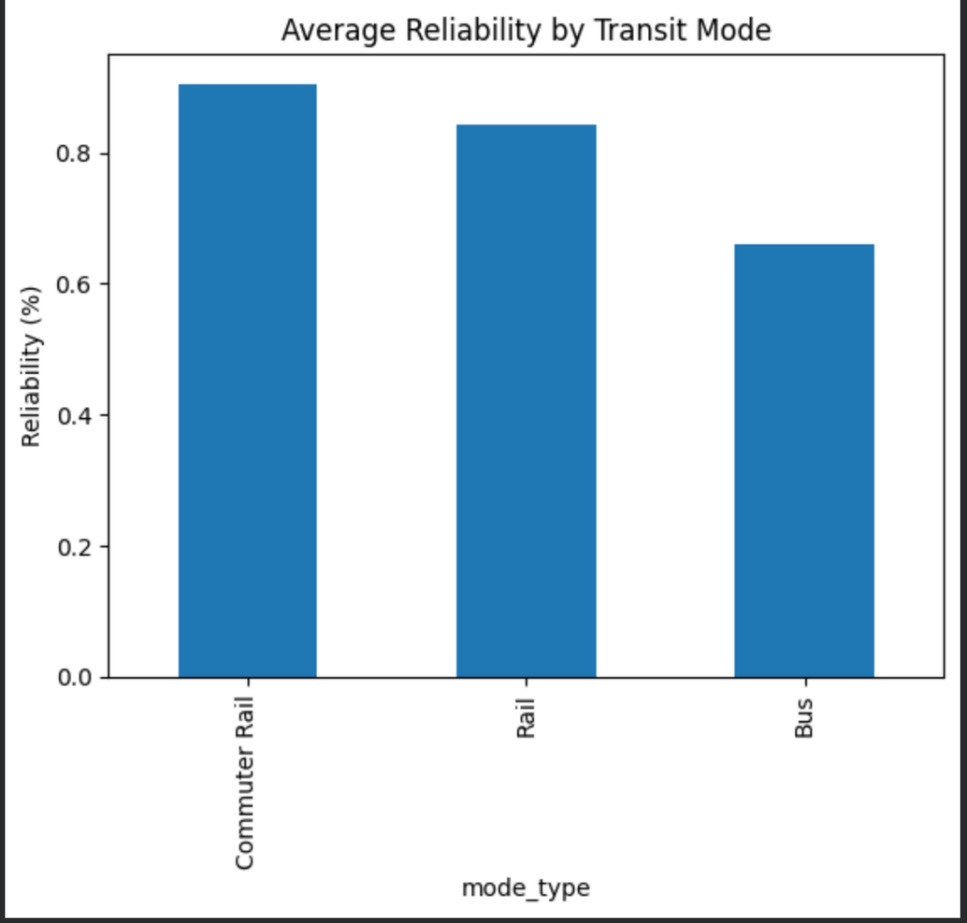
MBTA
This bar chart summarizes how average reliability differs by transit mode in the MBTA dataset
Rail modes (Commuter Rail and Rail) have the highest average reliability, both above 0.85, indicating they tend to run on schedule more consistently
Bus service shows noticeably lower average reliability, around 0.66–0.70, suggesting buses are more prone to delays relative to rail-based modes

Slide 7
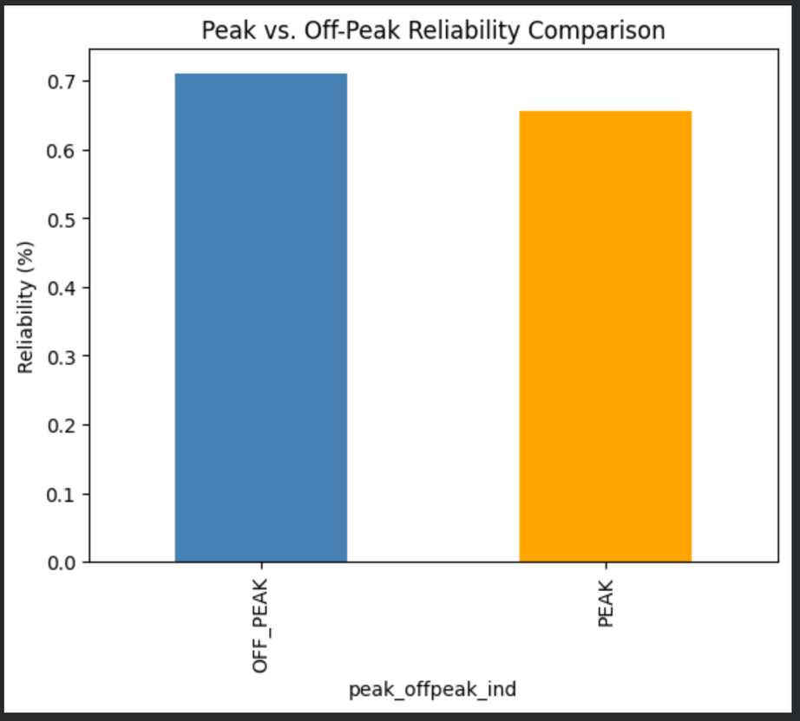
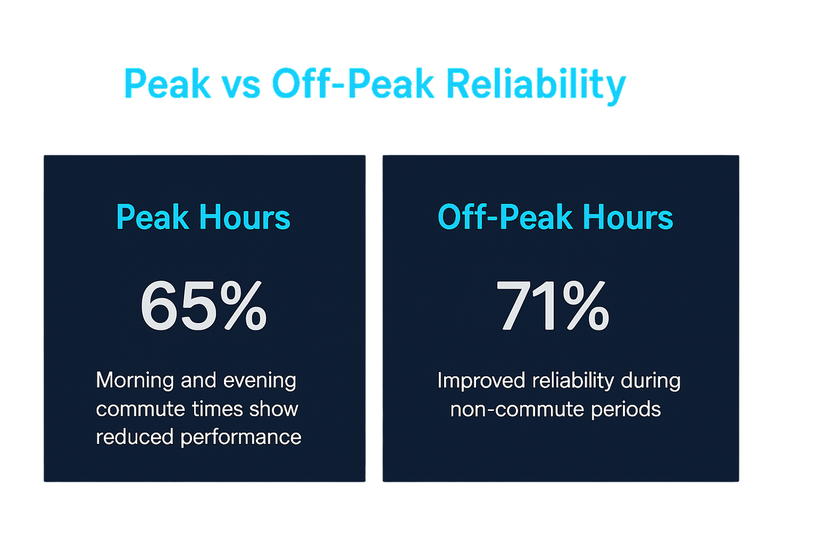
MBTA

Slide 8
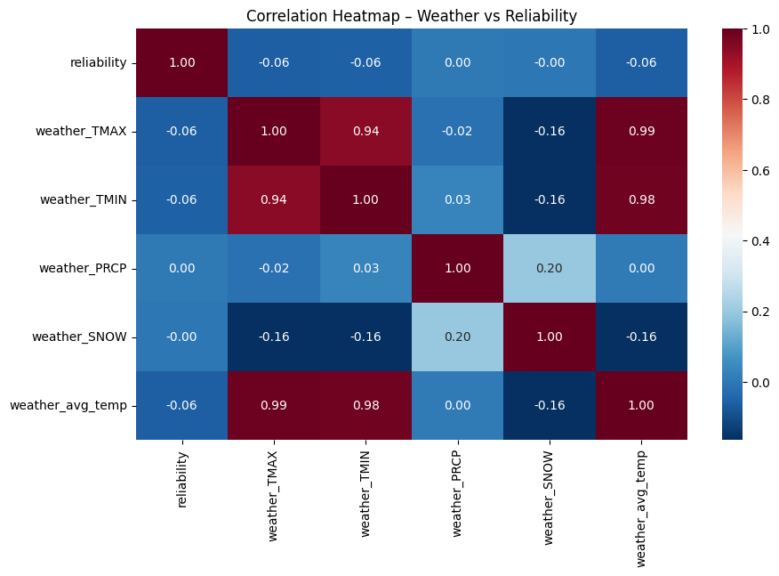
MBTA
Transit Mode Matters
Rapid Transit: 75% | Commuter Rail: 72% | Bus: 68%
Peak Hours Kill Reliability
Off-Peak: 71% | Peak: 65% (6-point drop)
Weather is Indirect
No direct correlation with reliability
Use interactions instead (e.g., Snow × Bus)
Drop avg_temp (redundant with TMAX)

Slide 9
RELIABILITY FACTOR
We created the target variable called “Reliability”, that represents the percentage of scheduled trips that actually arrived on time.
Reliability values | Meaning | Classification Label
>0.70 | Good Performance | Reliable (1)
≤0.70 | Bad Performance | Unreliable (0)

Slide 10
MBTA
MODEL
PERFORMANCE

Slide 11
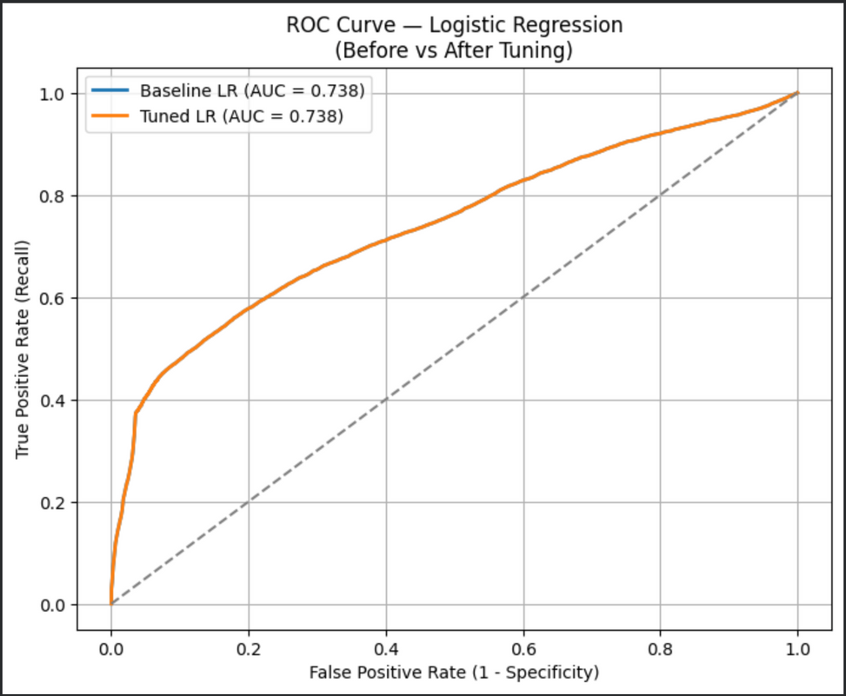
LOGISTIC REGRESSION MODEL
MBTA
Before Tuning
After Tuning
Precision: Class 0 → 0.65
Class 1 → 0.77
Precision: Class 0 → 0.65
Class 1 → 0.77
Recall: Class 0 → 0.84
Class 1 → 0.54
Recall: Class 0 → 0.84
Class 1 → 0.54
Accuracy: 0.69
Accuracy: 0.69

Slide 12
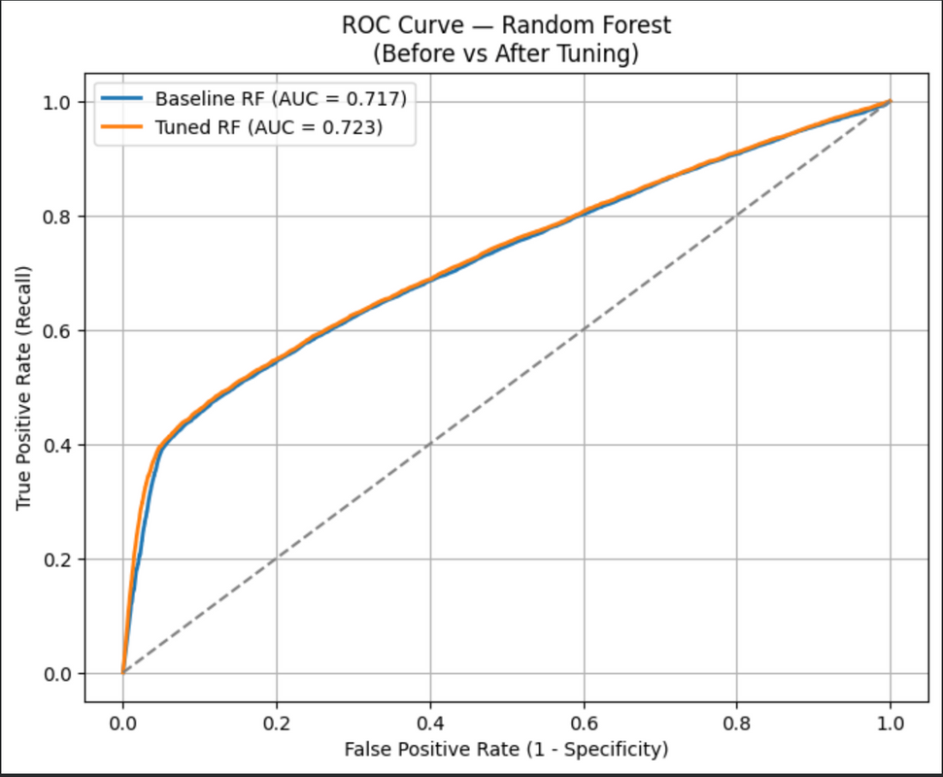
MBTA
RANDOM FOREST MODEL
Before Tuning
After Tuning
Precision: Class 0 → 0.65
Class 1 → 0.70
Precision: Class 0 → 0.75
Class 1 → 0.58
Recall: Class 0 → 0.65
Class 1 → 0.71
Recall: Class 0 → 0.76
Class 1 → 0.58
Accuracy: 0.67
Accuracy: 0.67

Slide 13
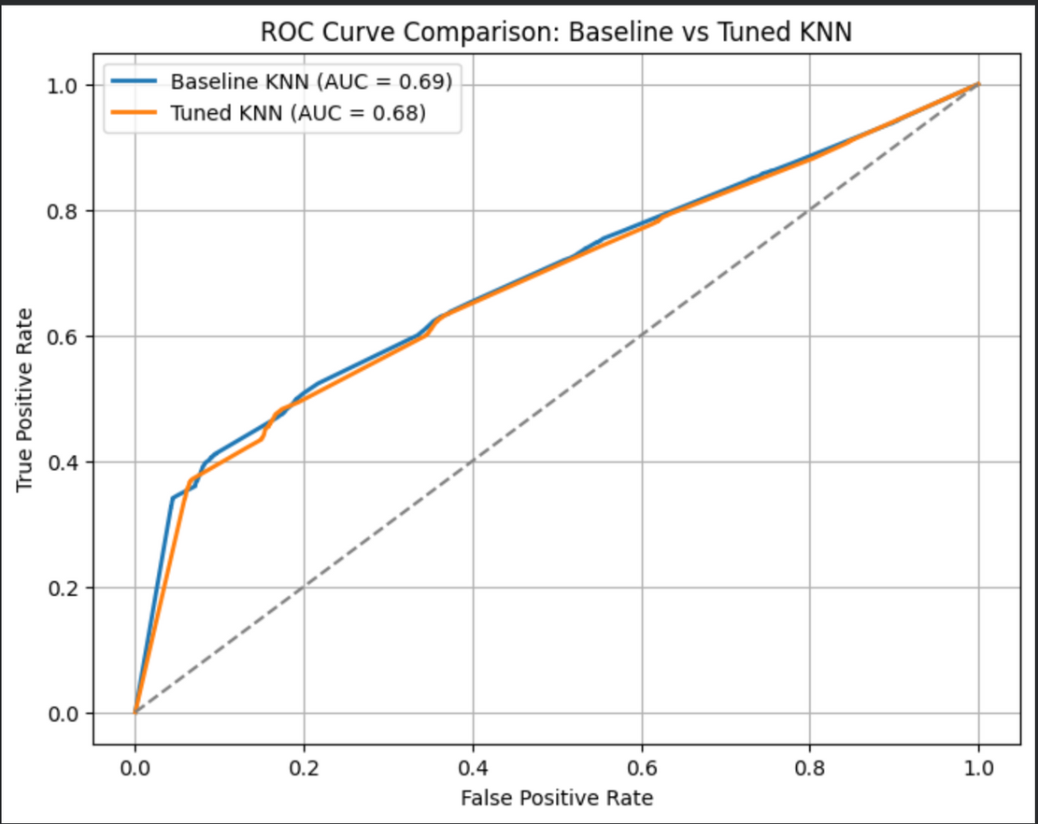
MBTA
KNN MODEL
Before Tuning
After Tuning
Precision: Class 0 → 0.63
Class 1 → 0.64
Precision: Class 0 → 0.63
Class 1 → 0.63
Recall: Class 0 → 0.65
Class 1 → 0.61
Recall: Class 0 → 0.65
Class 1 → 0.61
Accuracy: 0.63
Accuracy: 0.63

Slide 14
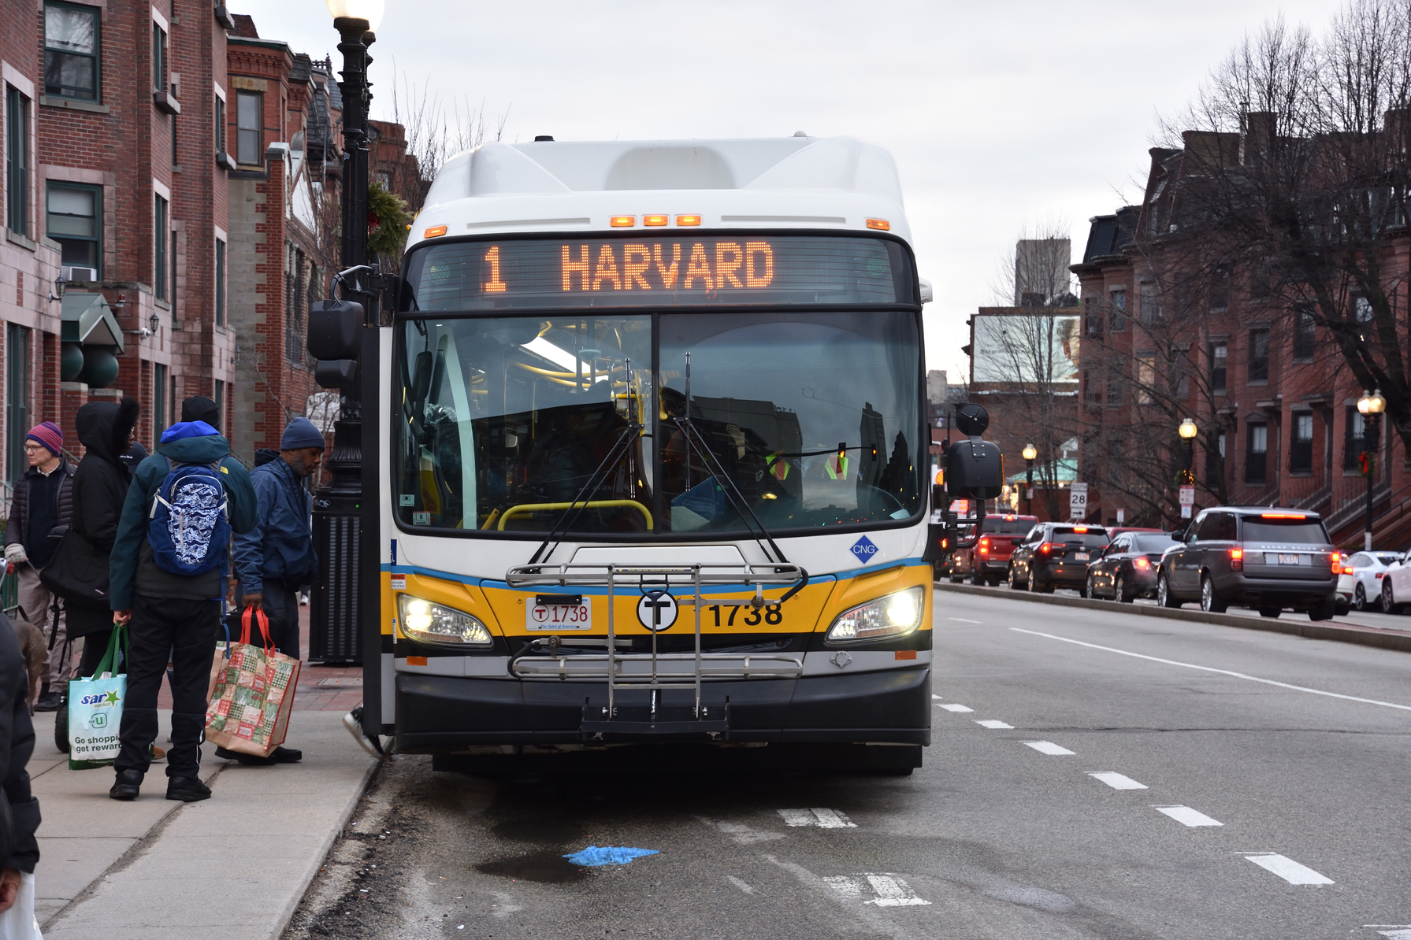
MODEL SELECTION
We have selected Random Forest as our go-to model
It provides the most reliable predictions of unreliable service days.while maintaining strong overall accuracy, making it the most suitable model for operational decision support at MBTA

Slide 15
CONCLUSION
Logistic Regression and Random Forest delivered the strongest performance
Logistic Regression: best ROC-AUC, highly interpretable baseline
Random Forest: higher recall for identifying unreliable service days
KNN: weak performance; inefficient on higher tuning
SVM: did not scale well and underperformed simpler models
Random Forest provides the best balance of accuracy, recall, and flexibility

Slide 16
RECOMMENDATION
Use Random Forest as the primary model for predicting unreliable service days
Captures nonlinear patterns across route, timing, and weather factors
Supports feature importance → better operational understanding
Keep Logistic Regression as a secondary, interpretable benchmark
Integrate predictions into dispatcher & scheduling workflows
Enable rider-facing alerts to inform commuters of expected delays

Slide 17
LIMITATIONS
Weather features had weak correlation with reliability → limited impact
Binary target may hide variation in borderline reliability cases
SVM constrained by computational inefficiency
Models assume historical patterns remain stable over time
Operational changes (policy, infrastructure upgrades) may disrupt patterns

Slide 18
MBTA
THANK YOU
Colab Notebook Link

